Slide 1
A presentation on Hyperledger Fabric
Sagnik Nayak
Chirantan Ganguly

Slide 2
What is Blockchain?
A Distributed Ledger
At the heart of a blockchain network is a distributed ledger that records all the transactions that take place on the network.
A blockchain ledger is often described as decentralized because it is replicated across many network participants, each of whom collaborate in its maintenance.
In addition to being decentralized and collaborative, the information recorded to a blockchain is append-only, using cryptographic techniques that guarantee that once a transaction has been added to the ledger it cannot be modified. This property of “immutability” makes it simple to determine the provenance of information because participants can be sure information has not been changed after the fact. It’s why blockchains are sometimes described as systems of proof.

Slide 3
What constitutes a Block?
1. Data: “Hello World!”
}
2. Prev. Hash: 034DFA357
From SHA algorithms (SHA256)
3. Hash: 4D56E1F05

Slide 4

Chain of Blocks
Genesis Block
1
2
3
1. Data: …
1. Data: …
1. Data: …
2. Prev. Hash: 000000000
2. Prev.Hash: 034DFA357
2. Prev. Hash: 4D56E1F05
3. Hash: 034DFA357
3. Hash: 4D56E1F05
3. Hash: 7364AEB2F
“Blocks are cryptographically linked together”

Slide 5
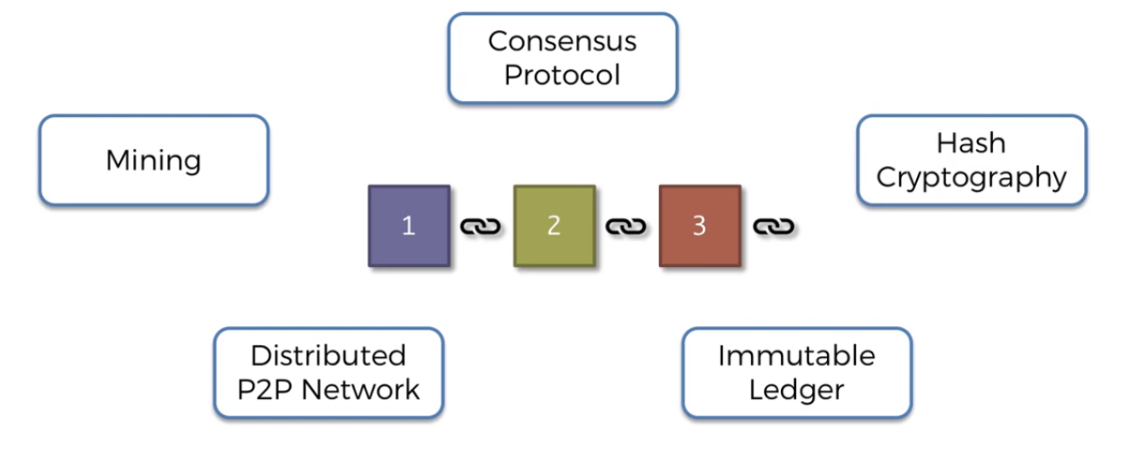

Slide 6
Smart Contracts
To support the consistent update of information — and to enable a whole host of ledger functions (transacting, querying, etc) — a blockchain network uses smart contracts to provide controlled access to the ledger.
Smart contracts are not only a key mechanism for encapsulating information and keeping it simple across the network, they can also be written to allow participants to execute certain aspects of transactions automatically.
A smart contract can, for example, be written to stipulate the cost of shipping an item where the shipping charge changes depending on how quickly the item arrives. With the terms agreed to by both parties and written to the ledger, the appropriate funds change hands automatically when the item is received.
In simple words – it defines the terms of the transaction which both parties must agree and verified by the network before execution

Slide 7
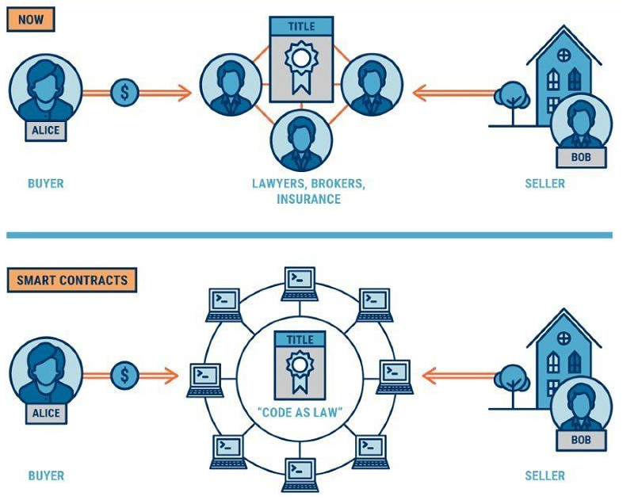

Slide 8
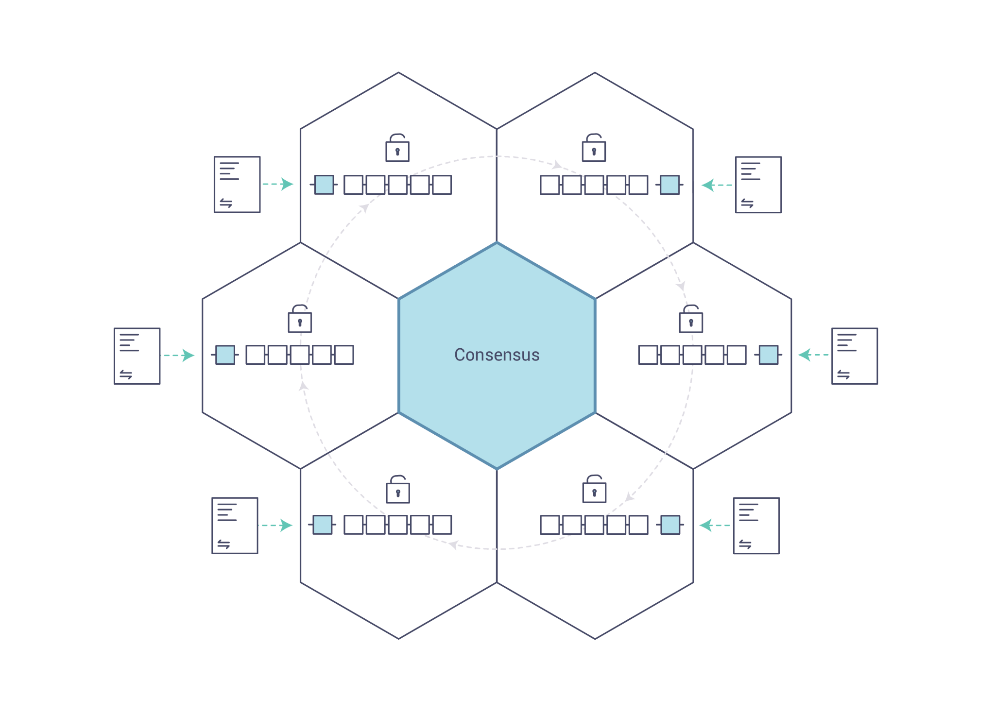
Consensus
The process of keeping the ledger transactions synchronized across the network — to ensure that ledgers update only when transactions are approved by the appropriate participants, and that when ledgers do update, they update with the same transactions in the same order — is called consensus.
Blockchain:
Shared, replicated transaction system which is updated via smart contracts and kept consistently synchronized through a collaborative process called consensus.

Slide 9

What is Hyperledger?
The Linux Foundation founded the Hyperledger project in 2015 to advance cross-industry blockchain technologies.
Hyperledger Fabric is a platform for distributed ledger solutions underpinned by a modular architecture delivering high degrees of confidentiality, resiliency, flexibility, and scalability.
It is designed to support pluggable implementations of different components and accommodate the complexity and intricacies that exist across the economic ecosystem.

Slide 10
What is Hyperledger Fabric?
Hyperledger Fabric is one of the blockchain projects within Hyperledger. Like other blockchain technologies, it has a ledger, uses smart contracts, and is a system by which participants manage their transactions.
Where Hyperledger Fabric breaks from some other blockchain systems is that it is private and permissioned. Rather than an open permissionless system that allows unknown identities to participate in the network, the members of a Hyperledger Fabric network enroll through a trusted Membership Service Provider (MSP).
Hyperledger Fabric offers the ability to create channels, allowing a group of participants to create a separate ledger of transactions. This is an especially important option for networks where some participants might be competitors and not want every transaction they make — a special price they’re offering to some participants and not others. If two participants form a channel, then those participants — and no others — have copies of the ledger for that channel.

Slide 11
Shared Ledger of Hyperledger Fabric
Hyperledger Fabric has a ledger subsystem comprising two components: the world state and the transaction log. Each participant has a copy of the ledger to every Hyperledger Fabric network they belong to.
World State Describes the state of the ledger at a given point in time. It’s the database of the ledger. | Transaction Log Records all transactions which have resulted in the current value of the world state; it’s the update history for the world state.
The ledger is a combination of the world state database and the transaction log history.

Slide 12
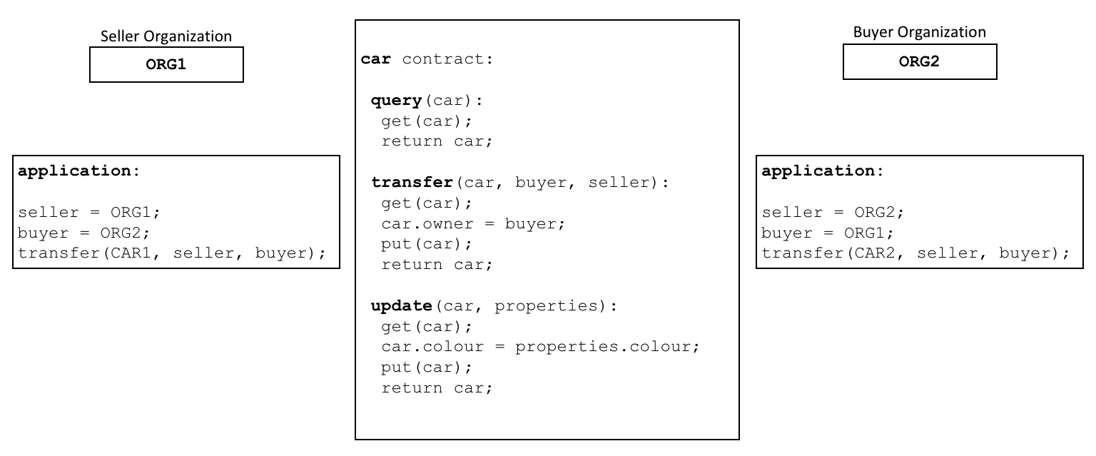
Smart Contracts in Hyperledger Fabric
Hyperledger Fabric smart contracts are written in chaincode and are invoked by an application external to the blockchain when that application needs to interact with the ledger.
In most cases, chaincode interacts only with the database component of the ledger, the world state (querying it, for example), and not the transaction log.
Chaincode can be implemented in several programming languages. Currently, Go, Node.js, and Java chaincode are supported.

Slide 13
Chaincode
Chaincode is software defining an asset or assets, and the transaction instructions for modifying the asset(s); in other words, it’s the business logic.
Chaincode enforces the rules for reading or altering key-value pairs or other state database information.
Chaincode functions execute against the ledger’s current state database and are initiated through a transaction proposal.
Chaincode execution results in a set of key-value writes (write set) that can be submitted to the network and applied to the ledger on all peers.
Assets can range from the tangible (real estate and hardware) to the intangible (contracts and intellectual property). Hyperledger Fabric provides the ability to modify assets using chaincode transactions.
Assets can be represented in binary and/or JSON form.

Slide 14
Privacy
Depending on the needs of a network, participants in a Business-to-Business (B2B) network might be extremely sensitive about how much information they share. For other networks, privacy will not be a top concern.
Hyperledger Fabric supports networks where privacy (using channels) is a key operational requirement as well as networks that are comparatively open.

Slide 15
Channels
Hyperledger Fabric allows an organization to simultaneously participate in multiple, separate blockchain networks via channels.
By joining multiple channels, an organization can participate in a so-called network of networks.
Channels provide an efficient sharing of infrastructure while maintaining data and communications privacy.
A channel provides a completely separate communication mechanism between a set of organizations. When a chaincode definition is committed to a channel, all the smart contracts within the chaincode are made available to the applications on that channel.

Slide 16
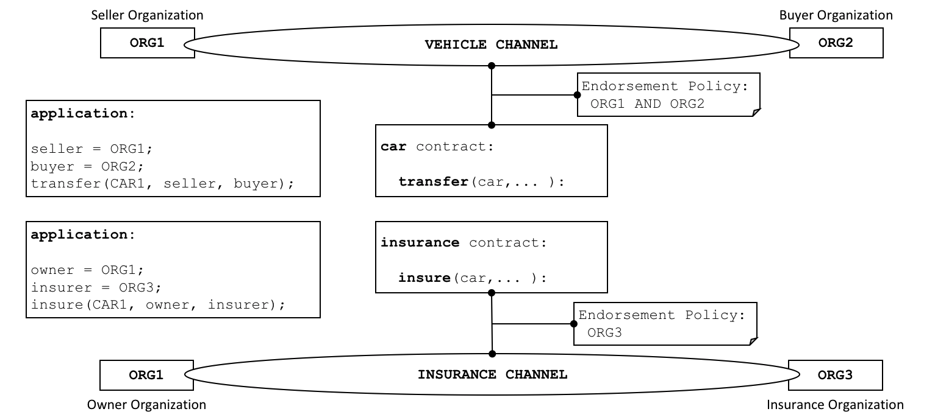

Slide 17
A simple implementation

Slide 18
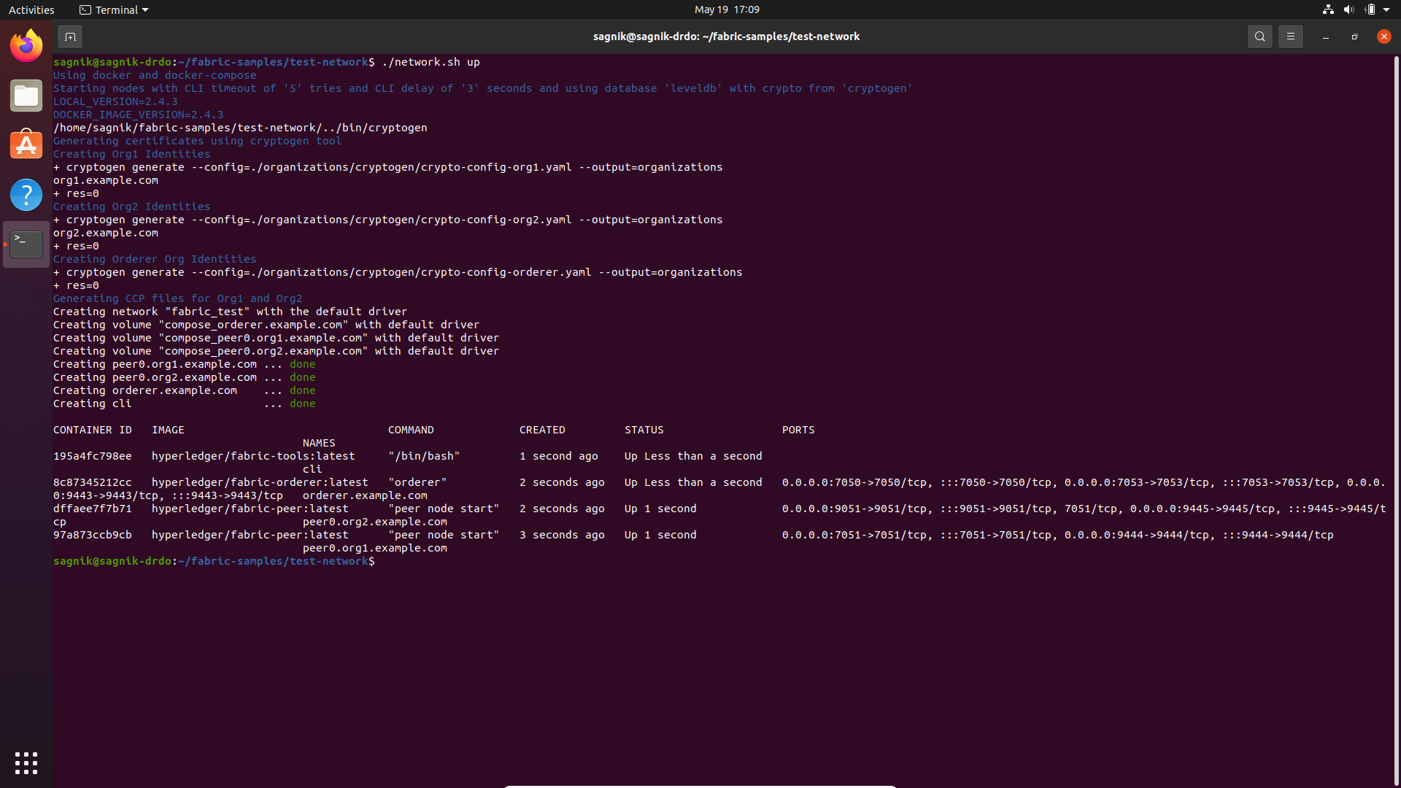
Setting up the network:
Here, network.sh file sets up the peers and their properties using the network configuration file.
Sets up a Certificate Authority (using a default cryptogen tool if not mentioned otherwise).
The following nodes are created using the network config file and the entire execution of processes are done within this network.

Slide 19
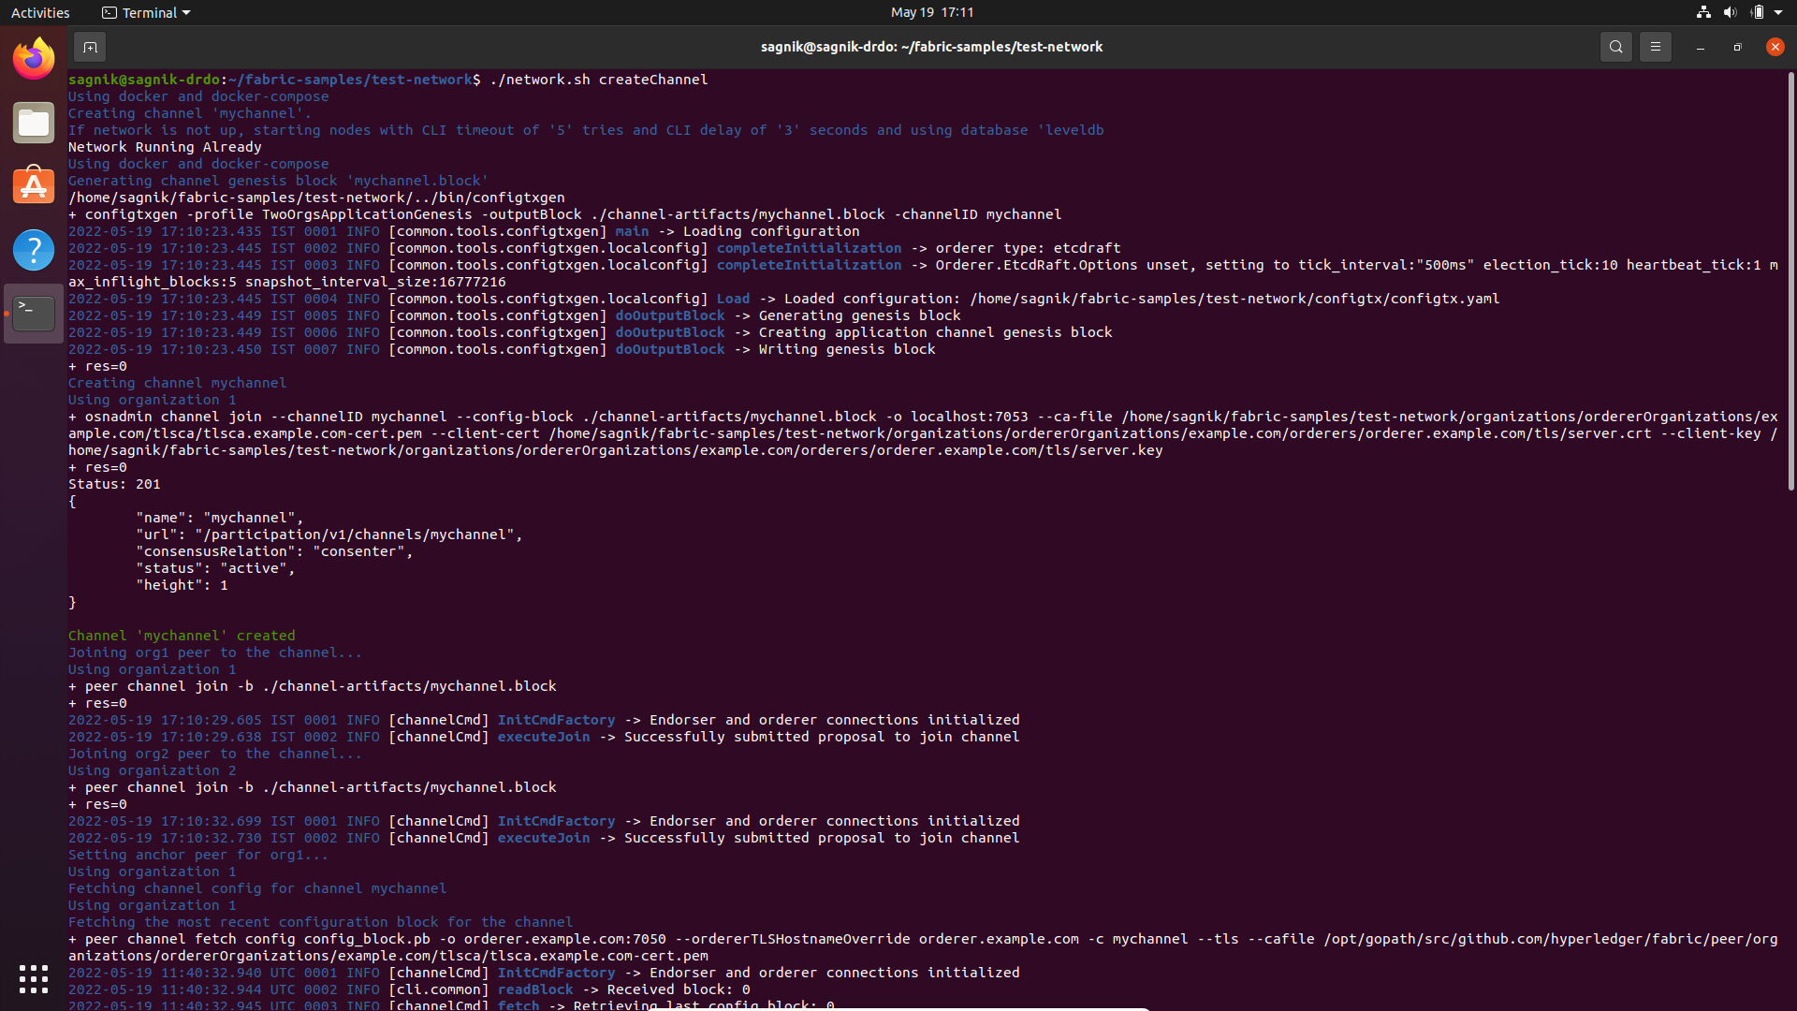
Creating Channels
The channel is created and anchored to two or more organizations as required by the developer.
We can see the default configuration of channel for this system. The default name here is ‘mychannel’.
We can select a name here using the -c parameter of the createChannel command.

Slide 20
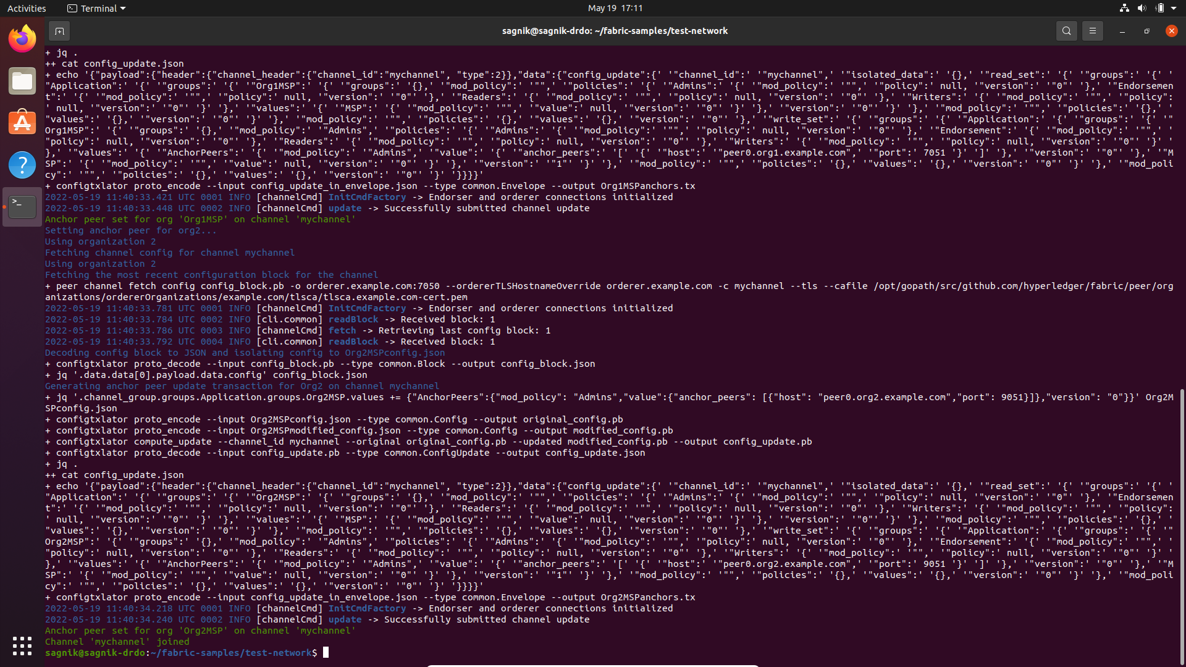
The channel created in this scenario consists of the following properties or parameters:
The properties define the channel, it’s access limitations, the policies and the organizations connected to it.
After the channel is set active and Anchor peers are set to the organization that are to communicate through the channel, the channel is joined.

Slide 21
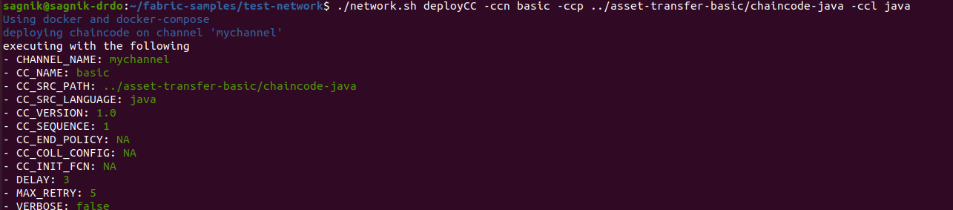
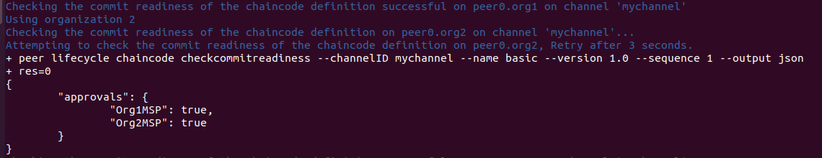
Chaincode deployment
Chaincode is deployed on a channel using the deployCC command with parameters -ccn (chaincode name),
-ccp (chaincode location),
-ccl (chaincode language, for compilation).
The packaged chaincode is then committed to the channel and is deployed/installed only after the organizations present on the channel approve it.
This ensures no untrusted smart contract is present on the channel.

Slide 22
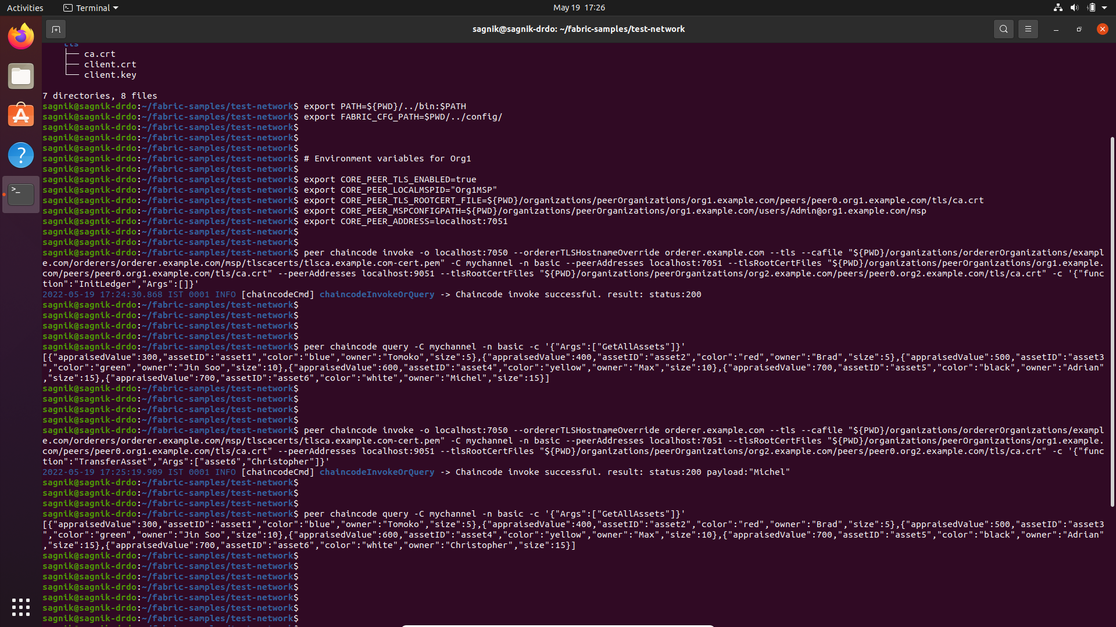
Using the CLI to invoke the chaincode
Firstly, we load the environment variables for peer belonging to Organization 1
InitLedger:
This function initializes the ledger belonging to the channel on which this chaincode is deployed. The Ledger across the peers belonging to the same channels are synced automatically.
GetAllAssets: This function in the chaincode returns all the assets maintained within the Ledger present on the channel
TransferAsset: This lets us interact with the ledger in a controlled and monitored way.

Slide 23
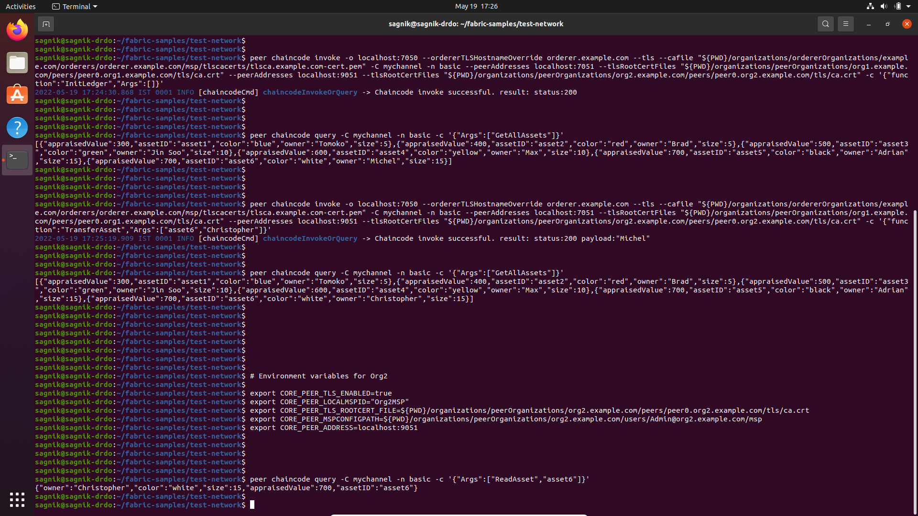
The parameters of an asset are changed only after approval is received from any/all the peers of the channel.
The change in ownership of asset6 is noticed to have changed from Michel to Christopher. This is a result of invoking the function TransferAsset with asset6 as the parameter.
The environment variables of the peer belonging to Org2 are loaded into to the terminal to use it as the CLI for Org2
On using the function ReadAsset using the parameter asset6, we can retrieve a copy of the asset present
in the ledger of Org2. On observing, we notice that
the asset present in the ledger of the Org2 has also been modified along with the ledger present in Org1 since they are synced.

Slide 24
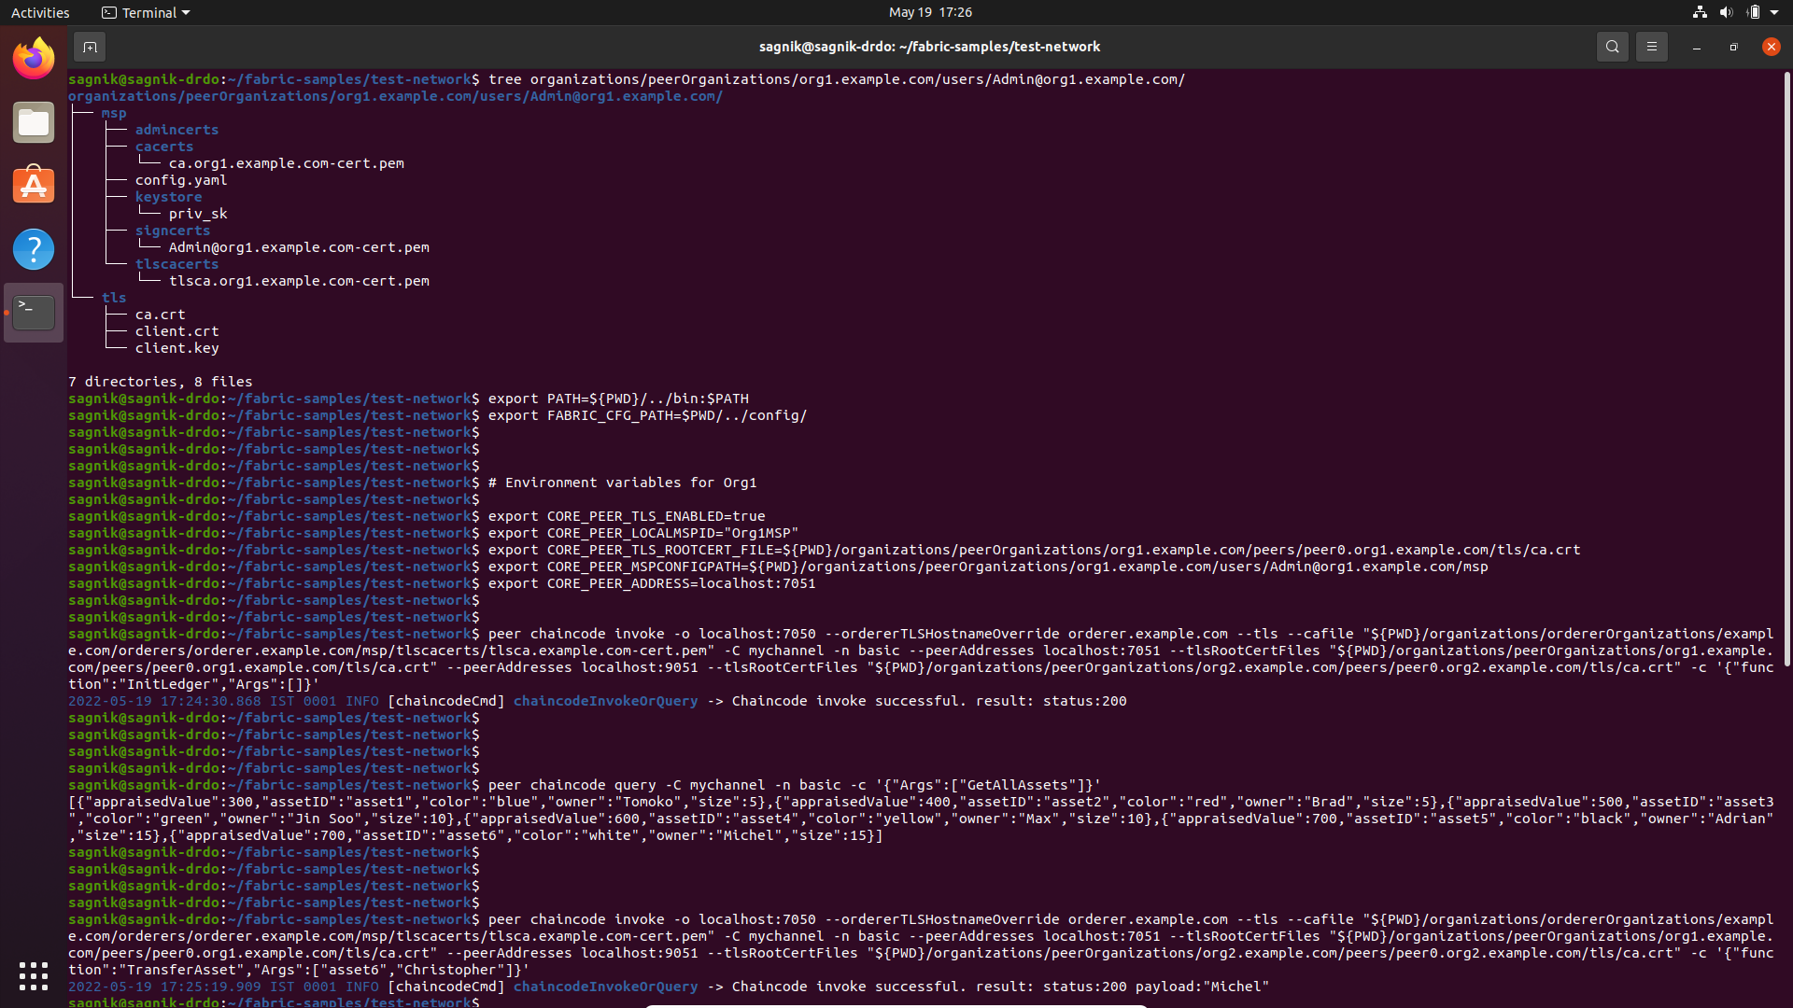
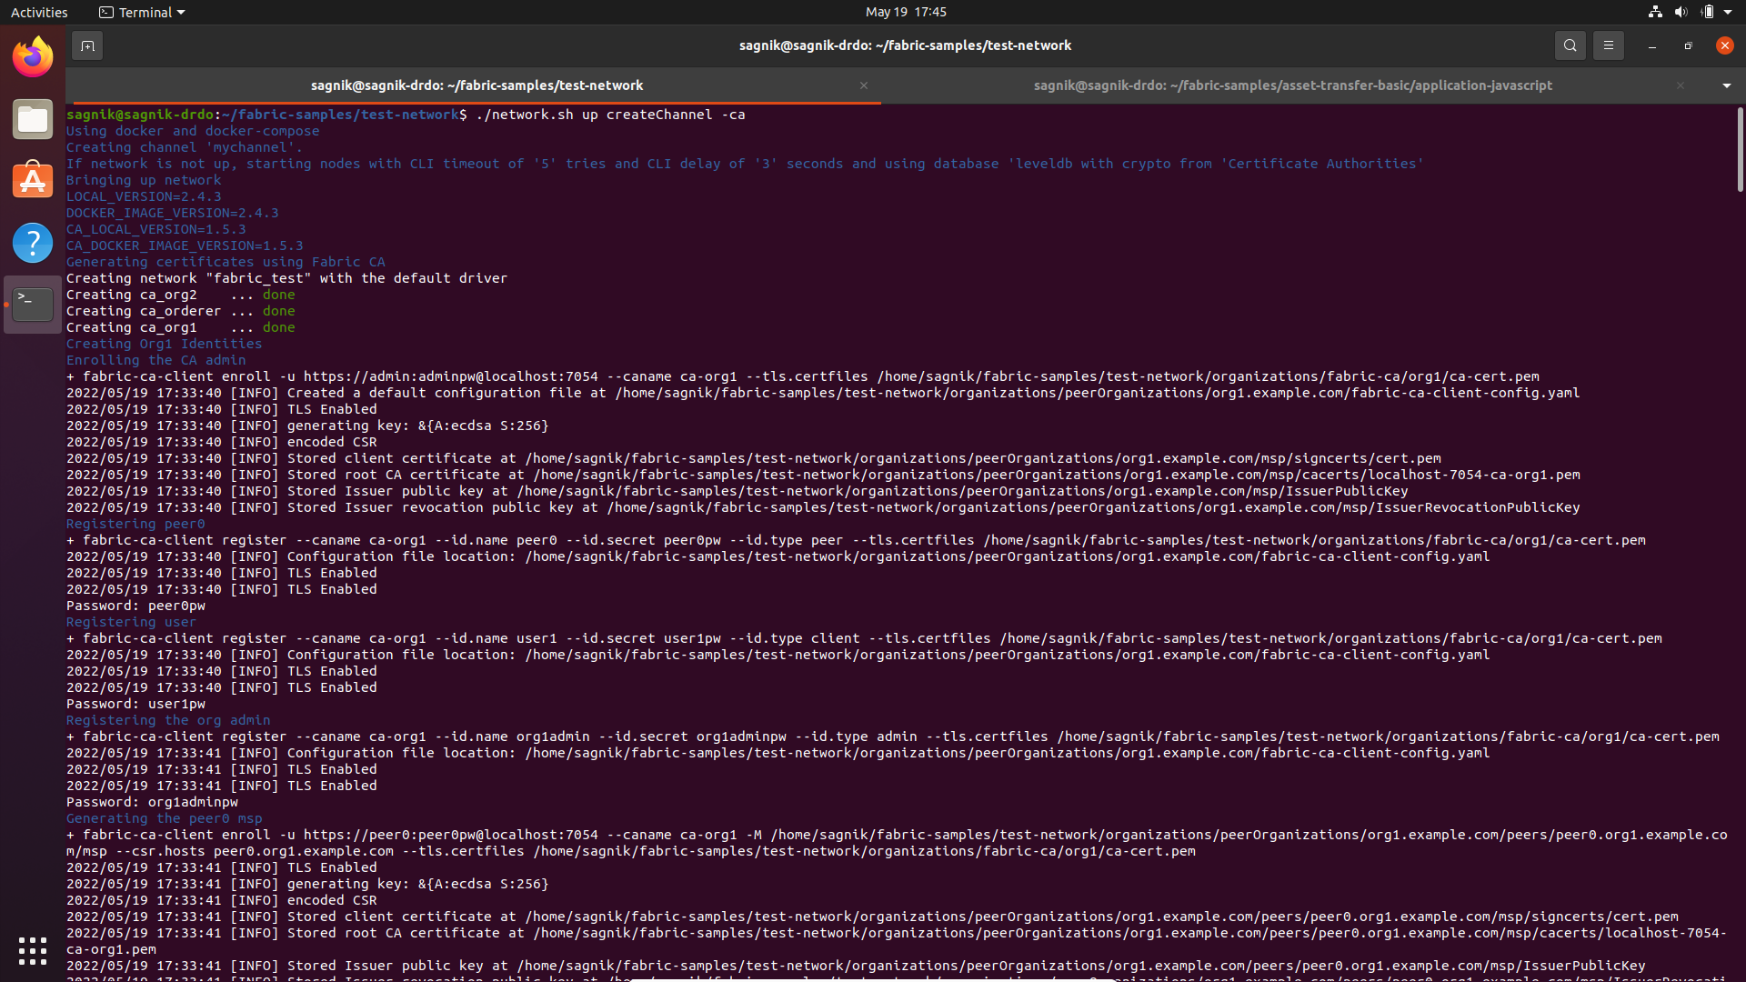
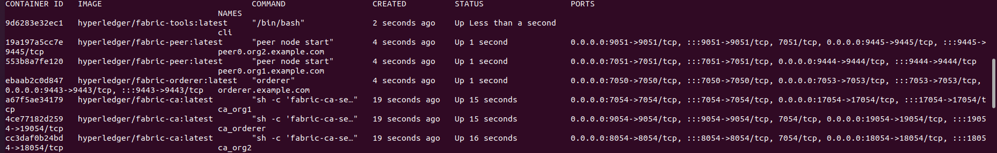
Certificate Authority
By default, Hyperledger fabric uses a cryptogen tool to generate certificates as shown here.
However, we can use a dedicated certificate authority peer for each organization in the network to ensure safety and trust among the organizations.
The certificate authority peers are seen to created in the picture on the right side, thus providing certificates to their dedicated organizations.
The total number of peers can be now observed as shown in the image below.

Slide 25
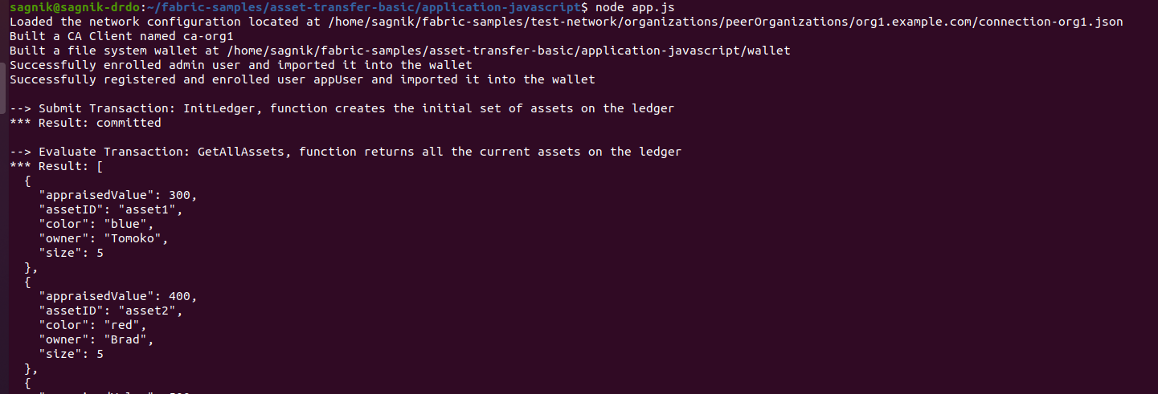
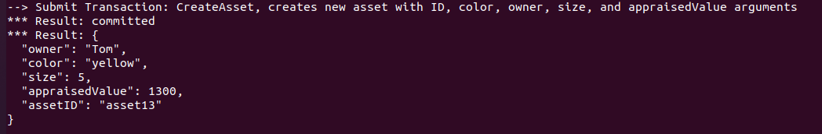
Running the app with node.js
Various functions which can be invoked are shown
GetAllAssets – shows all assets present
The assets
CreateAsset – creates a new asset

Slide 26
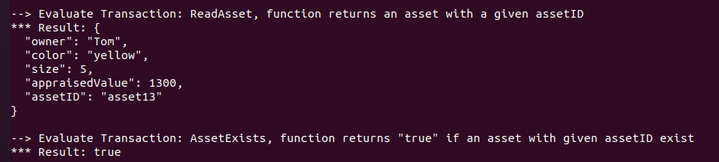
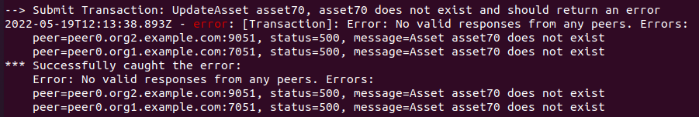
ReadAsset – shows the details of an asset
AssetExists– checks if an asset exists or not
Handling an error occurred when trying to update an asset which does not exist

Slide 27
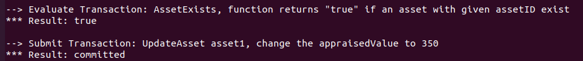
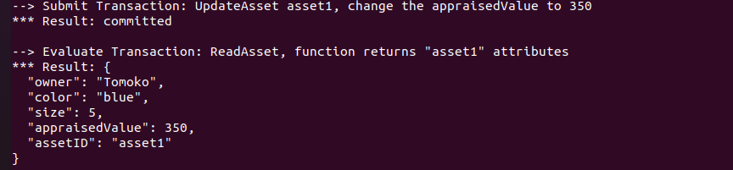
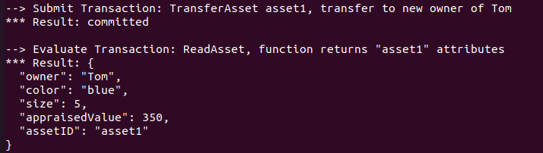
Updating an asset with valid asset ID, here the appraised value
is changed from 300 to 350
Updating an asset to change ownership from ‘Tomoko’ to ‘Tom’

Slide 28
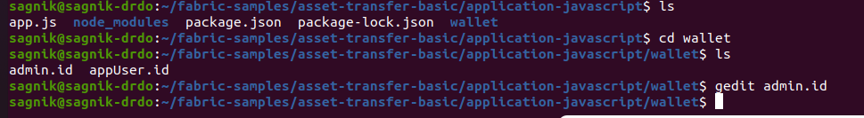
Wallet
A wallet, in this scenario does not act as a wallet that we see in real life. This wallet does not contain any currency or anything that you can earn or spend on the network. Instead it contains the identity of the user/client who is using the app to interact with the blockchain.
This wallet consists of private and public keys for communication, which also provides various levels of access that can be granted to peers or clients connecting to the secure network.

Slide 29
Concluding
Hyperledger fabric provides a secure private blockchain network which can be used to build distributed apps to do asset management of various classes (tangible and non-tangible). It could be even used to make communication between various parties accountable as they are securely stored in the ledger.
Has already ben used by multiple organizations and the case studies could provide insight for future development. Case studies can be found here : https://www.hyperledger.org/learn/case-studies

Slide 30
Thank You

